Slide 1
Image Encryption Using Rubik’s Cube Based Algorithm
Kushal Ghimire(073/BCT/533)
Mohit Joshi (073/BCT/538)
Moses Thapa Magar (073/BCT/539)
Nirajan Karki (073/BCT/544)

Slide 2
Overview
Introduction
Objective
Literature Review
Why this Algorithm?
Requirement Analysis
Feasibility Study
System Design And Architecture
Methodology
Applications
Result and Output
References

Slide 3
Introduction
Image Encryption required due to illegal copying and distribution
Transform image securely so that no unauthorized user can access it
Rubik’s cube is deployed which only changes the position of the pixels
In Rubik’s Cube principle, XOR operator is applied to rows and column of image using a key

Slide 4
Objective
To provide security of image-based data with the help of suitable key and protect the image from illegal copying and distribution.

Slide 5
Literature Review
Many research papers on Image Encryption
Many Image Encryption Algorithms were used
Mostly used algorithms includes AES, DES, Digital Signature Algorithm
Many researches have been done to test the level of security

Slide 6
Why this Algorithm?
No data loss during encryption or decryption of image.
Encrypted image quality is same as the original image.
The resultant image can be encrypted any number of times.
This algorithm has high key sensitivity, i.e. image is encrypted again if wrong key is entered.

Slide 7
Requirement Analysis
Functional Requirements
Ask user two input keys
Send keys through E-mail
Image size is not affected
Security

Slide 8
Non-Functional Requirements
Accessibility
Efficiency
Reliability

Slide 9
Software Requirements
Photoshop
Python 3.7
SQLite
Atom IDE
Hardware Requirements
No specific or complex hardware
Normal PC with dual core processor

Slide 10
Feasibility Study
Economic Feasibility
Technical Feasibility
Time Feasibility

Slide 11
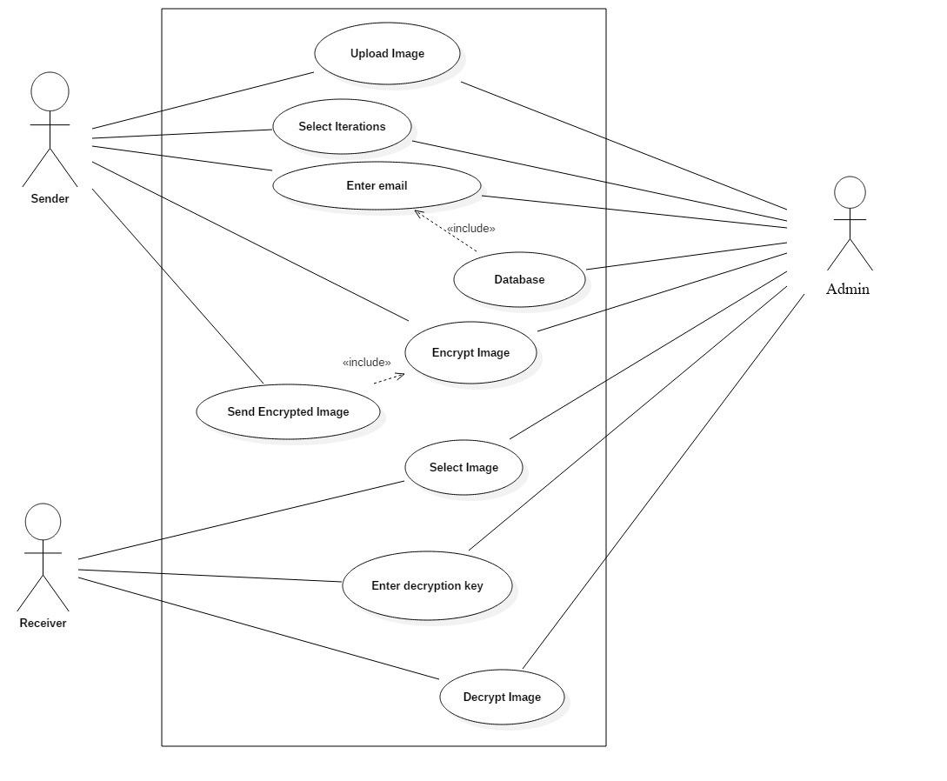
System Design And Architecture
Fig: Use Case Diagram

Slide 12
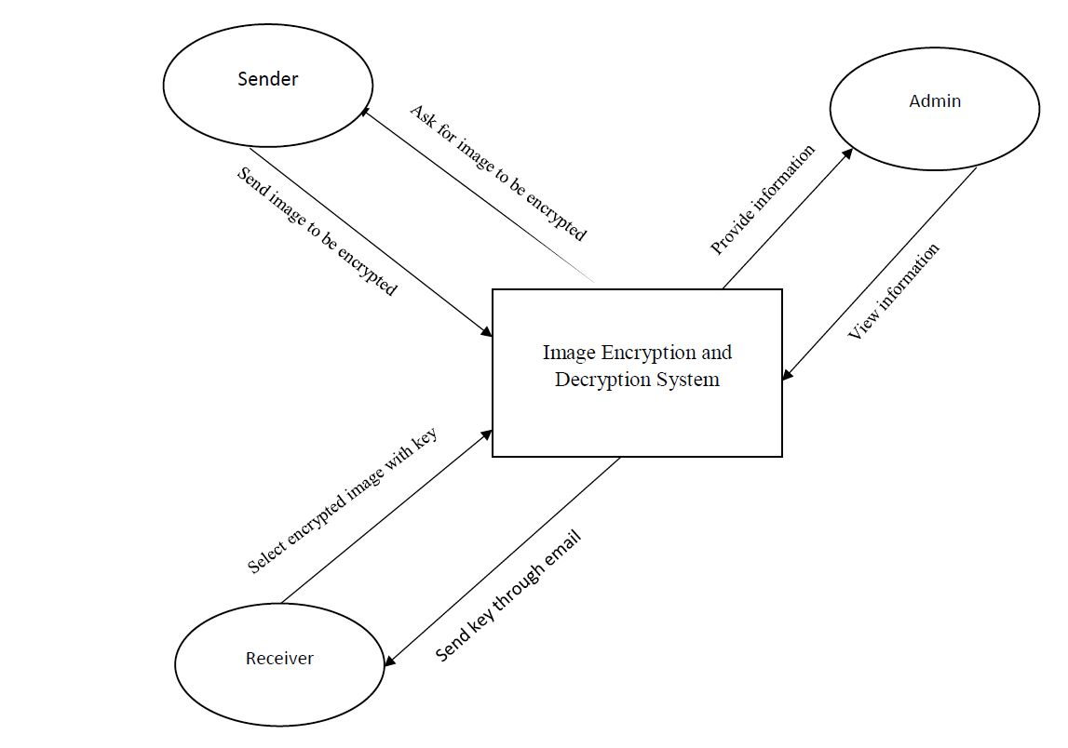
DFD Level 0
Fig: DFD Level 0

Slide 13
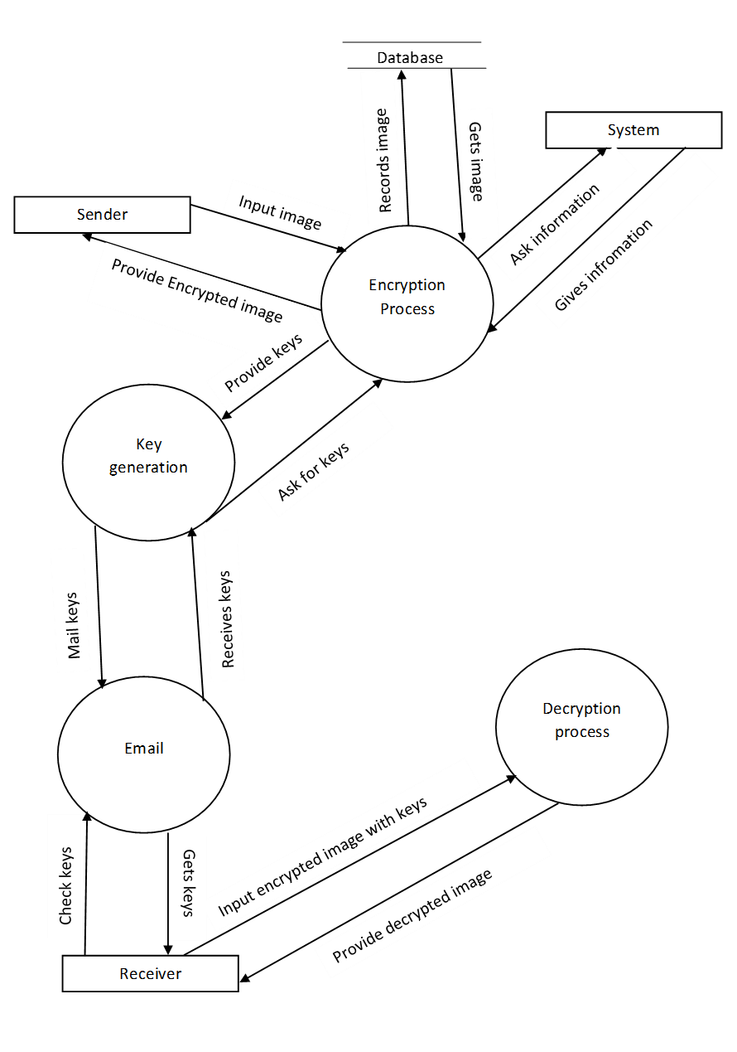
DFD Level 1

Slide 14
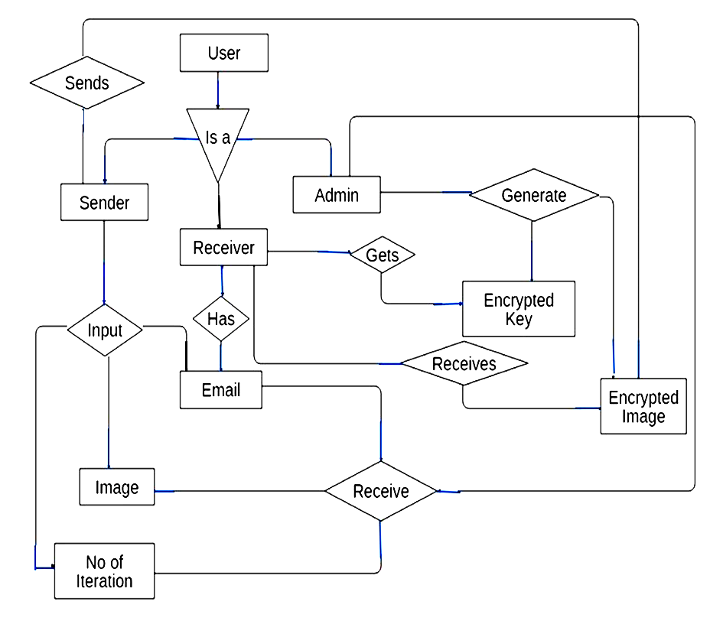
Entity Relationship Diagram (ERD)

Slide 15
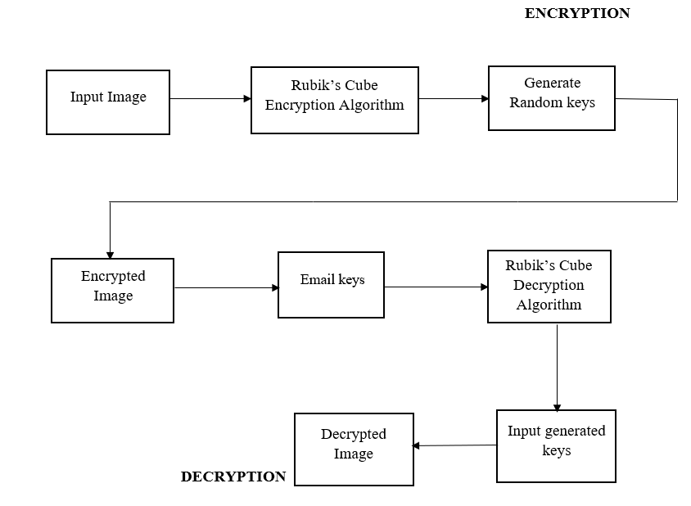
System Diagram

Slide 16
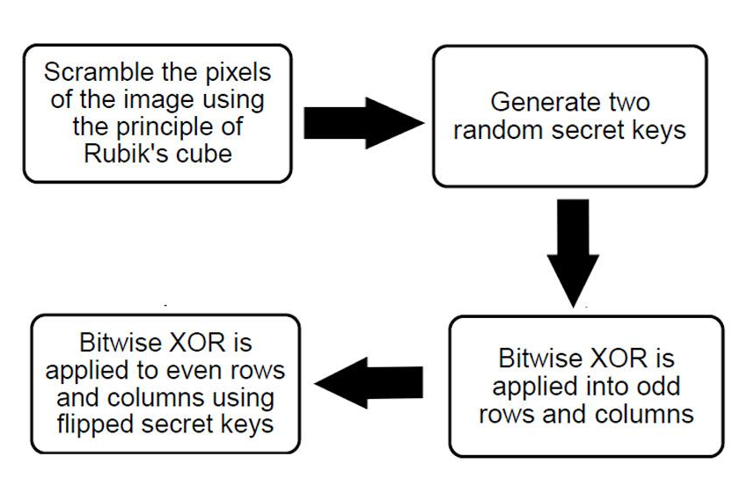
Flow Diagram
Fig: Flow diagram of Rubik’s Cube Encryption

Slide 17
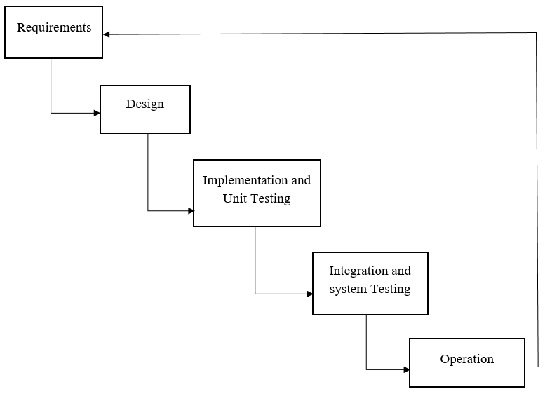
Methodology
Fig: Incremental Model

Slide 18
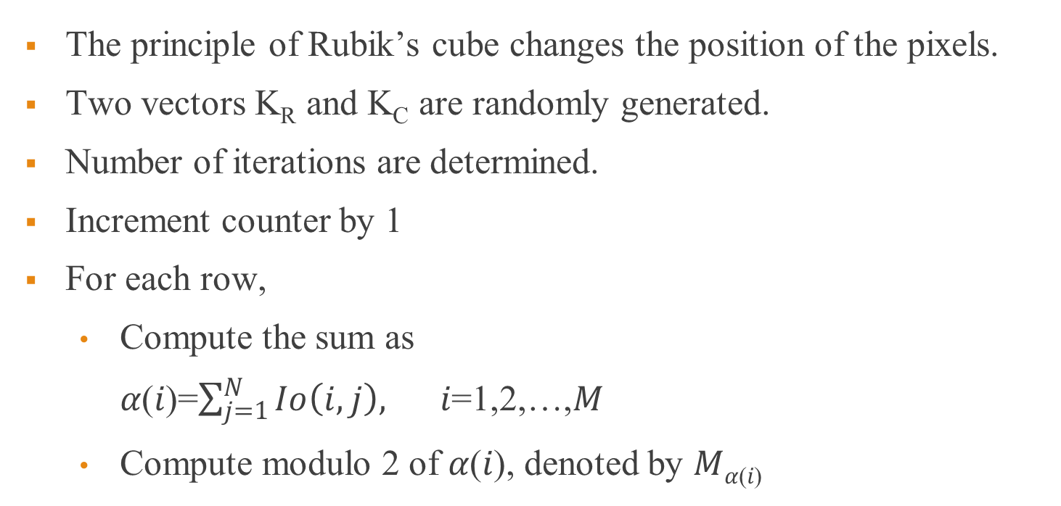
Rubik’s Cube Encryption Algorithm
The principle of Rubik’s cube changes the position of the pixels.
Two vectors K_{R} and K_{C} are randomly generated.
Number of iterations are determined.
Increment counter by 1
For each row,
Compute the sum as
𝛼(𝑖)=$\sum_{j=1}^{N}{Io\left(i,j\right),}$ 𝑖=1,2,…,𝑀
Compute modulo 2 of 𝛼(𝑖), denoted by 𝑀_{𝛼(𝑖)}

Slide 19
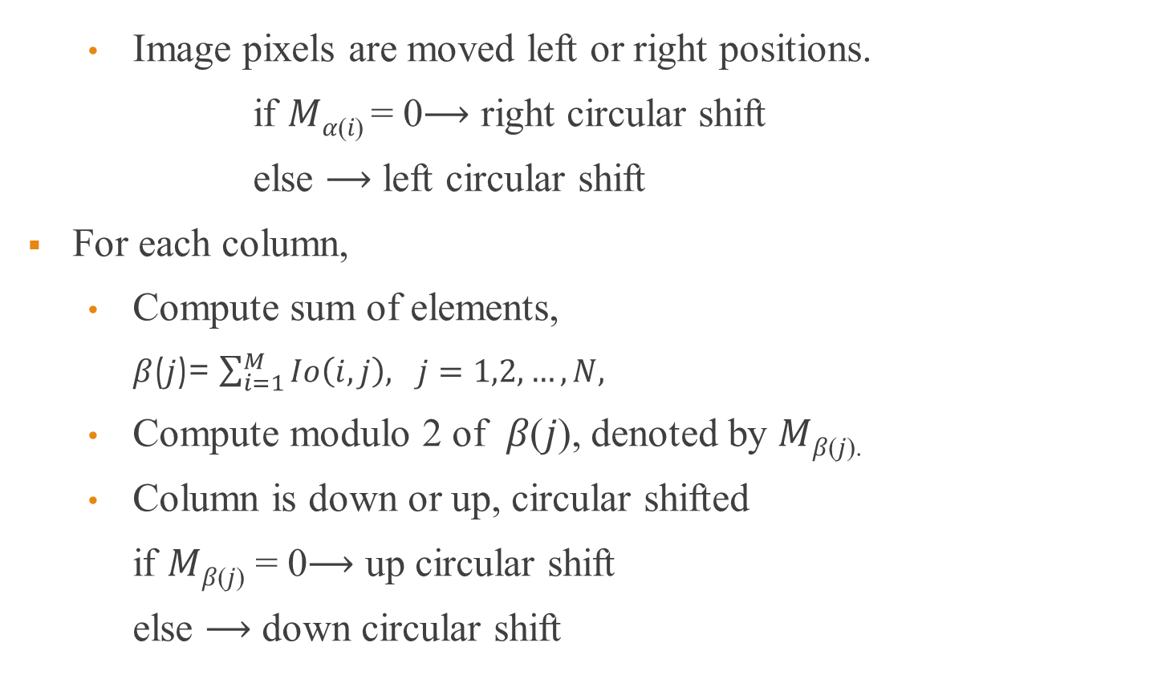
Contd.
Image pixels are moved left or right positions.
if 𝑀_{𝛼(𝑖)} = 0⟶ right circular shift
else ⟶ left circular shift
For each column,
Compute sum of elements,
𝛽(𝑗)= $\sum_{i=1}^{M}{Io\left(i,j\right), j=1,2,…,N,}$
Compute modulo 2 of 𝛽(𝑗), denoted by 𝑀_{𝛽(𝑗).}
Column is down or up, circular shifted
if 𝑀_{𝛽(𝑗)} = 0⟶ up circular shift
else ⟶ down circular shift

Slide 20
Contd.
Using vector 𝐾_{𝐶}, the bitwise XOR operator is applied to each row of scrambled image 𝐼_{SCR} using:
𝖨₁ (2𝑖−1, 𝑗) = 𝖨_{SCR} (2𝑖−1, 𝑗) ⊕ 𝐾_{𝐶} (𝑗),
𝖨₁(2𝑖, 𝑗) = 𝖨_{SCR} (2𝑖, 𝑗) ⊕ rot 180( k_{𝐶}(𝑗) )
Using vector 𝐾_{𝑅}, the bitwise XOR operator is applied to each column of image 𝐼₁ using:
𝖨_{ENC} (𝑖, 2𝑗−1) = 𝖨₁ (𝑖, 2𝑗−1) ⊕ 𝐾_{𝑅} (𝑗),
𝖨_{ENC} (𝑖, 2𝑗 ) = 𝖨₁ (𝑖, 2𝑗) ⊕ rot 180 (k_{𝑅} (𝑗))
After Iteration is completed, the encrypted image is created, else goes to step 4

Slide 21
Flowchart
A

Slide 22
A

Slide 23
Applications
Governmental as well as non-governmental organizations.
Places where data needs to be secure from external threats.
Devices where sensitive image is stored.
Hacker targeted areas.

Slide 24
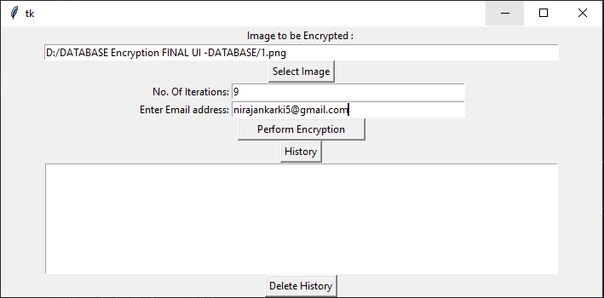
Result and Output
After the implementation of this project, the result is shown as in figure below:
XYZ@gmail.com
Fig: Encryption User Interface

Slide 25
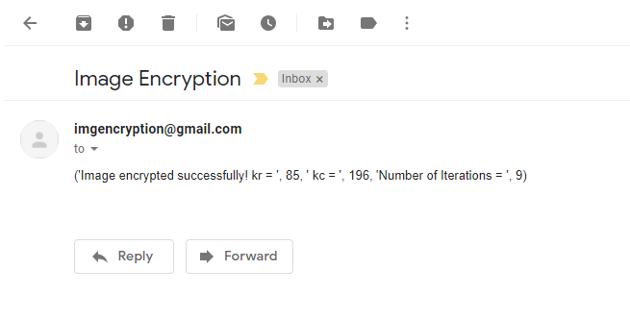
Contd.
Fig: Email sent through the system

Slide 26

Contd.
Fig: Decryption User Interface

Slide 27
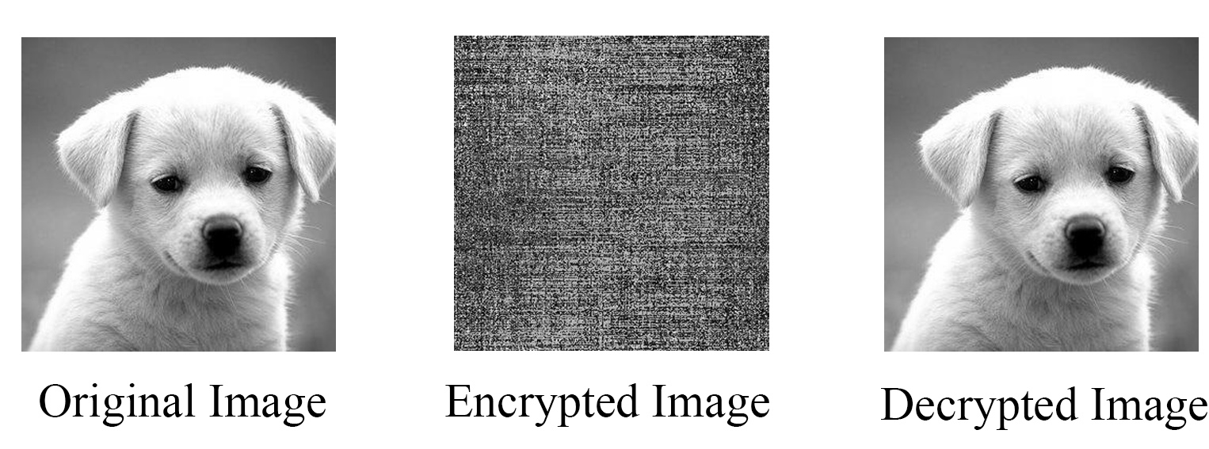
Contd.
Fig: Sample Output

Slide 28
References
Cryptology, History (http://www.faqs.org/espionage/Cou- De/Cryptology-History)
Y. Wang, K. W. Wong, X. Liao, and G. Chen, “A new chaos-based fast image encryption algorithm,” Applied Soft Computing Journal, vol. 11, no. 1, pp. 514–522, 2011.
“An Improved Secure Image Encryption Algorithm Based on Rubik's Cube Principle and Digital Chaotic Cipher”, Adrian-Viorel Diaconu and Khaled Loukhaoukha, Mathematical Problems in Engineering, Volume 2013, Article ID 848392, 10 pages
(http://dx.doi.org/10.1155/2013/848392)

Slide 29
Thank You!

